Slide 1

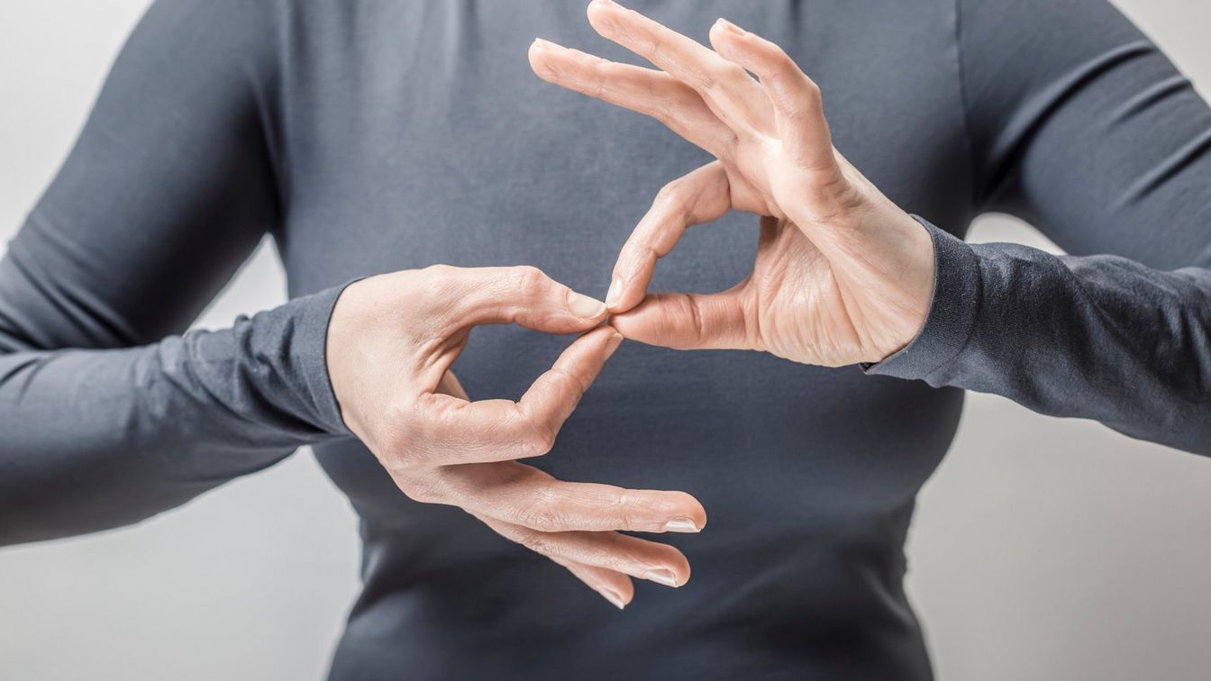
GestureLink
Real-Time Sign Language Translation Agent with
Context-Aware Assistance

Slide 2

Table of Contents
Introduction
Objectives
Methodology and Implementation
Experiment Setup
Usability
Future Scope

Slide 3

Introduction

Slide 4
Problem :
Over 466 million people worldwide are deaf or hard-of-hearing, facing significant communication barriers.Limited access to human interpreters and real-time information exacerbates social exclusion and vulnerability.In critical situations (e.g., healthcare, emergencies), these barriers can have life-altering consequences.
Solution :
GestureLink: An AI-powered agent that bridges the communication gap through real-time sign language translation and context-aware assistance.Combines Computer Vision (CV) for sign language recognition, Natural Language Processing (NLP) for bidirectional translation, and Retrieval-Augmented Generation (RAG) for dynamic information retrieval services independently

Slide 5
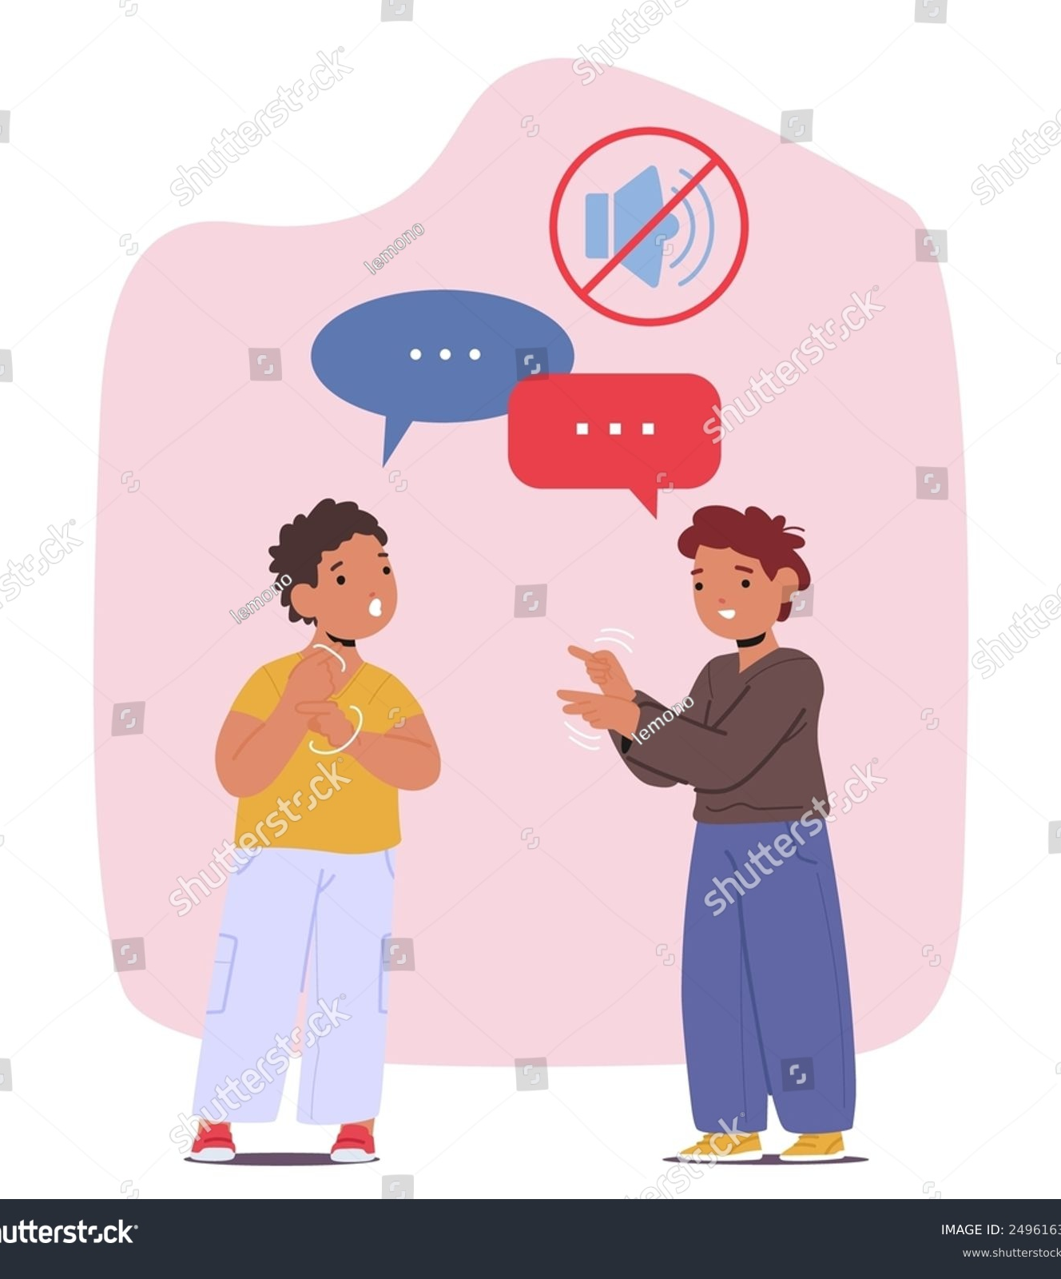
Objectives

Slide 6
Develop a Real-time Sign Language Translation System:
Use Computer Vision (CV) to accurately detect and interpret sign language gestures in real-time.
Support multiple sign languages, including regional and underrepresented dialects.
Achieve low-latency processing for seamless communication.
Integrate Context-Aware Assistance using RAG :
Use Retrieval-Augmented Generation (RAG) to fetch real-time, contextually relevant information.
Ensure the system adapts to dynamic queries and provides accurate, up-to-date responses.
Promote Inclusivity And Accessibility:
Design the system to be accessible across platforms (web, mobile, kiosks).
Ensure compatibility with assistive technologies (e.g., screen readers) .
Prioritize user privacy and data security.

Slide 7
Optimise for Scalability and Adaptability:
Build a modular system that can easily integrate new sign languages with minimal data.
Optimise the AI models for deployment on low-resource devices (e.g., edge devices, smartphones).
Enable offline functionality for areas with limited internet connectivity.
Demonstrate Measurable Impact :
Conduct pilot tests with deaf communities to gather feedback and improve the system.
Measure key metrics:
Accuracy of sign language recognition.
Response time for real-time translation.
User satisfaction and ease of use.
Showcase real-world applications in healthcare, education, and emergency services.
Foster Collaboration and Adoption :
Partner with NGOs, governments, and educational institutions for large-scale deployment.
Raise awareness about the importance of inclusive communication tools.
Provide training and resources to help users adopt the technology effectively.

Slide 8

Methodology and Implementation

Slide 9
Problem Analysis and Requirement Gathering :
Objective: Understand the needs of the deaf/hard-of-hearing community and define system requirements.
Steps:
Conduct surveys and interviews with deaf users, interpreters, and stakeholders.
Identify key pain points (e.g., lack of real-time translation, limited access to information).
Define functional and non-functional requirements (e.g., accuracy, latency, scalability).

Slide 10
Sign Language Recognition (Computer Vision):
Objective: Develop a real-time sign language recognition system.
Steps:
Train a deep learning model (e.g., CNN, Transformer-based architectures) on preprocessed data.
Use transfer learning to adapt models for regional sign languages with limited data.
Optimise for real-time performance using lightweight frameworks (e.g., TensorFlow Lite, ONNX).
Integrate with a webcam or smartphone camera for live gesture detection.
Translation and Conversation (Natural Language Processing):
Objective: Enable bidirectional communication between sign language and text
Steps:
Sign-to-Text: Use sequence models (e.g., Transformers) to map detected gestures to text.
Text-to-Speech: Integrate TTS APIs (e.g., Google Cloud, Amazon Polly) for vocal responses.
Text-to-Sign: Develop an animation system to convert text into sign language avatars.
Use LangChain to orchestrate workflows (e.g., triggering RAG for complex queries).

Slide 11
Contextual Assistance (Retrieval-Augmented Generation - RAG):
Objective: Provide real-time, context-aware information retrieval.
Steps:
Fine-tune a pre-trained language model (e.g., GPT, BERT)
for domain-specific queries.
Implement a retrieval mechanism to fetch relevant documents or
data based on user queries.
Generate concise, accurate responses using the RAG pipeline.
System Integration and Deployment:
Objective: Combine all components into a cohesive, user-friendly system.
Steps:
Develop a web/mobile interface for seamless user interaction.
Use Flask/Django for backend and React Native for frontend development.
Integrate CV, NLP, and RAG modules into a unified pipeline.
Deploy the system on cloud platforms (e.g., AWS, Google Cloud) for scalability.

Slide 12

Experimentation Setup

Slide 13
Hardware Requirements:
Cameras: High-resolution webcams or smartphone cameras for real-time gesture detection.
Processing Units: GPUs (e.g., NVIDIA Tesla T4) for training and inference.
Edge Devices: Smartphones or tablets for on-device deployment.
Software Requirements:
Frameworks: PyTorch, TensorFlow, MediaPipe, Hugging Face Transformers.
APIs: Google Cloud Speech-to-Text, Amazon Polly (TTS).
Databases: Elastic search, FAISS for RAG integration.

Slide 14
Dataset:
Sign Language Datasets:
RWTH-PHOENIX-Weather 2014 (German Sign Language).
ASLLVD (American Sign Language Lexicon Video Dataset).
Custom datasets for regional sign languages (e.g., Indian Sign Language).
Augmentation: Synthetic data generation to improve model robustness.
Evaluation Metrics:
Sign Recognition Accuracy: Percentage of correctly identified gestures.
Translation Latency: Time taken for real-time sign-to-text conversion.
RAG Accuracy: Precision and recall of retrieved information.
User Satisfaction: Measured through surveys and feedback.

Slide 15

Usability

Slide 16
User-Centred Design Principles :
Inclusivity: Designed for both deaf and hearing users, ensuring accessibility for all.
Simplicity: Intuitive interface with minimal learning curve.
Feedback: Real-time feedback for user actions (e.g., confirmation of gesture detection).
Consistency: Uniform design and interaction patterns across platforms (web, mobile, kiosks).
Key Usability Features :
Visual Design: Clean, clutter-free layout with large buttons and readable fonts.
Navigation: Simple menu structure with clear labels (e.g., “Translate,” “Emergency Help”).
Accessibility: High-contrast colour schemes and support for screen readers.

Slide 17
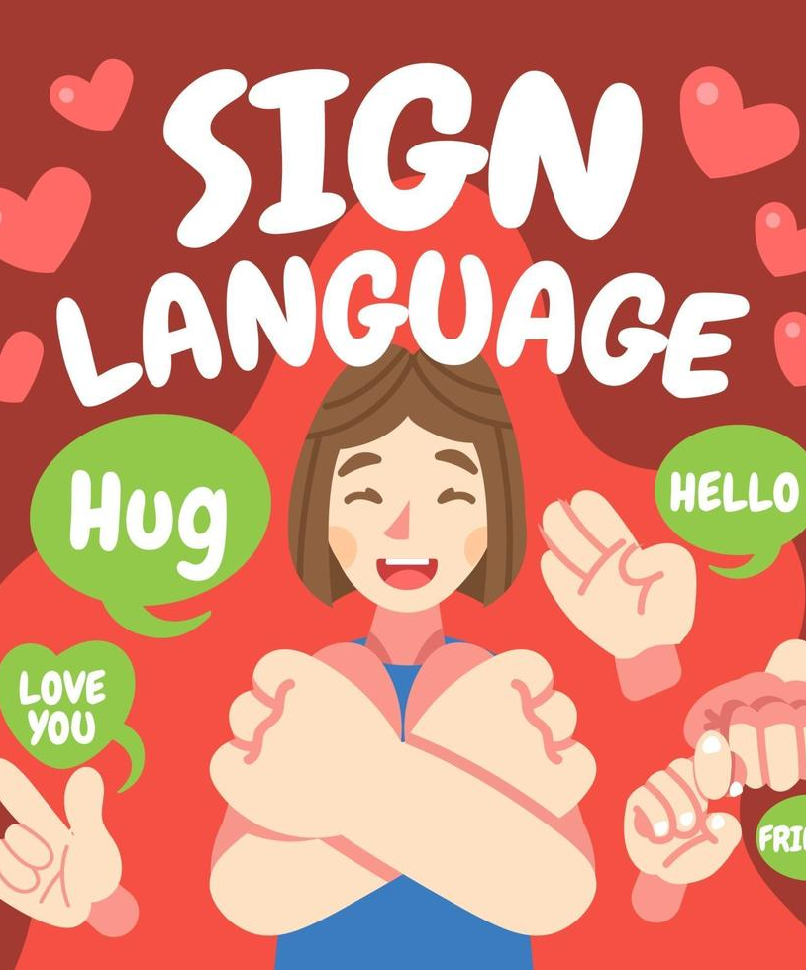
Future Scope

Slide 18
Enhancing Real-Time Performance:
Goal: Improve the speed and accuracy of real-time translation.
Actions:
Optimise models for edge devices (e.g., smartphones, tablets) to reduce latency.
Implement model quantisation and pruning to reduce computational requirements.
Integration with Wearable Devices:
Goal: Make GestureLink more portable and accessible through wearable technology.
Actions:
Develop versions for smart glasses (e.g., Google Glass, AR devices) for hands-free interaction.
Integrate with smartwatches for quick access to translation and assistance.
Use haptic feedback for notifications and alerts.

Slide 19
Link :

Slide 20
Thank you !!

